Slide 1
Chapter 11: Analysis of Variance

Slide 2
Understanding Analysis of Variance
ANOVA: Inferential statistics technique.
t Test: Difference between two means.
ANOVA extends to two or more groups.
One-way ANOVA.
Differences examined by ANOVA.
Notes:
Satisfies Learning Objective 11.1: Explain the application of a one-way analysis of variance (ANOVA) model.
Analysis of variance (ANOVA) is an inferential statistics technique designed to test for a significant relationship between two variables in two or more groups or samples.
t-Test: It examines the difference between two means, $\overline{Y_{1}}−\overline{Y_{2}}$, while the null hypothesis assumes that there was no difference between them: $μ_{1}=μ_{2}$. Rejecting the null hypothesis means that there is a significant difference between the two mean scores (or the populations from which the samples were drawn).
ANOVA extends to two or more groups: The logic of ANOVA is the same as t test, but extending to two or more groups. ANOVA will allow us to examine the variation among four means ($\overline{Y_{1}}, \overline{Y_{2}},\overline{Y_{3}}, \overline{Y_{4}}$), and the null hypothesis can be stated as follows: $μ_{1}=μ_{2}=μ_{3}=μ_{4}$. Rejecting the null hypothesis for ANOVA indicates that there is a significant variation among the four samples.
One-way ANOVA: When ANOVA procedures are applied to data with one dependent and one independent variable, it is called a one-way ANOVA.
Differences examined by ANOVA: To determine whether the differences are significant, ANOVA examines:
The differences between the samples.
The differences within a single sample.
The differences can also be referred to as variance or variation, which is why ANOVA is the analysis of variance.
ANOVA allows us to determine whether the variance between samples is larger than the variance within the samples.

Slide 3
The Structure of Hypothesis Testing with ANOVA (1 of 6)
The Assumptions
Independent random samples.
Dependent variable: Interval-ratio level.
Population: Normally distributed.
Population variances are equal.
Notes:
Satisfies Learning Objective 11.2: Define the concepts of between and within total variance.
ANOVA requires several assumptions regarding method of sampling, the level of measurement, the shape of the population distribution, and the homogeneity of variance.
Independent random samples are used: Our choice of sample members from one population has no effect on the choice of sample members from the second, third, or fourth population.
Dependent variable: The dependent variable is an interval-ratio level of measurement. Some researchers also apply ANOVA to ordinal-level measurements.
Population is normally distributed: Although we cannot confirm whether the populations are normal, given that our N is so small, we must assume that the population is normally distributed to proceed with our analysis.
Population variances are equal: The population variances are equal. Based on calculations, the sample variances, although not identical, are relatively homogeneous.

Slide 4
The Structure of Hypothesis Testing with ANOVA (2 of 6)
Stating the Research and the Null Hypotheses and Setting Alpha
Research hypothesis: At least one of the means is different.
Alpha: Probability of rejecting null hypothesis.
Notes:
Satisfies Learning Objective 11.2: Define the concepts of between and within total variance.
Research hypothesis (H₁) proposes, at least one of the means is different: We do not identify which one(s) will be different, or larger or smaller, we only predict that a difference does exist. H₁: At least one mean is different from the others. ANOVA is a test of the null hypothesis of no difference between any of the means. Since we’re working with four samples, we include four $μ_{s}$ in our null hypothesis. $H_{0}: μ_{1}=μ_{2}=μ_{3}=μ_{4}$.
Alpha: Probability of rejecting null hypothesis: As we did in other models of hypothesis testing, we’ll have to set our alpha. Alpha is the level of probability at which we’ll reject our null hypothesis. For this example, we’ll set alpha at 0.05.

Slide 5
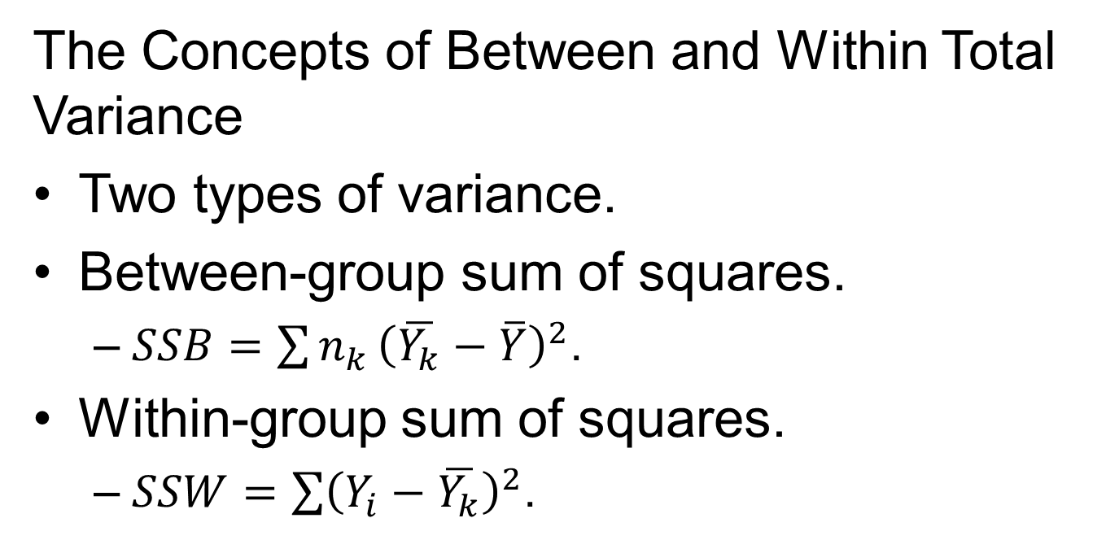
The Structure of Hypothesis Testing with ANOVA (3 of 6)
The Concepts of between and within Total Variance
Two types of variance.
Between-group sum of squares.
  $SSB=\sum{n_{k}}{\left(\overline{Y_{k}}−\overline{Y}\right)}^{2}$.
Within-group sum of squares.
  $SSW=\sum{{\left(Y_{i}−\overline{Y_{k}}\right)}^{2}}$.
Notes:
Satisfies Learning Objective 11.2: Define the concepts of between and within total variance.
Two types of variance: Primary set of calculations has to do with the two types of variance:
Between-group variance.
Within-group variance.
The estimate of each variance has two parts, the sum of squares and degrees of freedom (df).
Between-group sum of squares: The between-group sum of squares (the sum of squared deviations between each sample mean to the overall mean score) or SSB measures the difference in average years of education between our four groups. Sum of squares is the abbreviation for “sum of squared deviations.” For SSB, what we’re measuring is the sum of squared deviations between each sample mean to the overall mean score. The formula for the SSB can be presented as follows:
$SSB=\sum{n_{k}}{\left(\overline{Y_{k}}−\overline{Y}\right)}^{2}$
where $n_{k}$is the number of cases in a sample (k represents the number of different samples), $\overline{Y_{k}}$is the mean of a sample, and $\overline{Y}$ is the overall mean.
SSB can also be understood as the amount of variation in the dependent variable (years of education) that can be attributed to or explained by the independent variable (the four demographic groups).
Within-group sum of squares (sum of squared deviations within each group, calculated between each individual score and the sample mean) or SSW measures the variation of scores within a single sample. SSW is also referred to as the amount of unexplained variance, since this is what remains after we consider the effect of the specified independent variable. The formula for SSW measures the sum of squared deviations within each group, between each individual score with its sample mean:
$SSW=\sum{{\left(Y_{i}−\overline{Y_{k}}\right)}^{2}}$
where $Y_{i}$ is each individual score in a sample and $\overline{Y_{k}}$ is the mean of a sample.
Even with our small sample size, if we were to use this formula, we’d have a tedious and cumbersome set of calculations. Instead, we suggest using the following computational formula for within-group variation or SSW:
$SSW=\sum{Y_{i}^{2}−\sum{\frac{{\left(\sum{Y_{k}}\right)}^{2}}{n_{k}}}}$
where $Y_{i}^{2}$ is the squared scores from each sample, $\sum{Y_{k} }$ is the sum of the scores of each sample, and $n_{k}$ is the number of cases in a sample.
Together, the explained (SSB) and unexplained (SSW) variances compose the amount of total variation in scores.

Slide 6
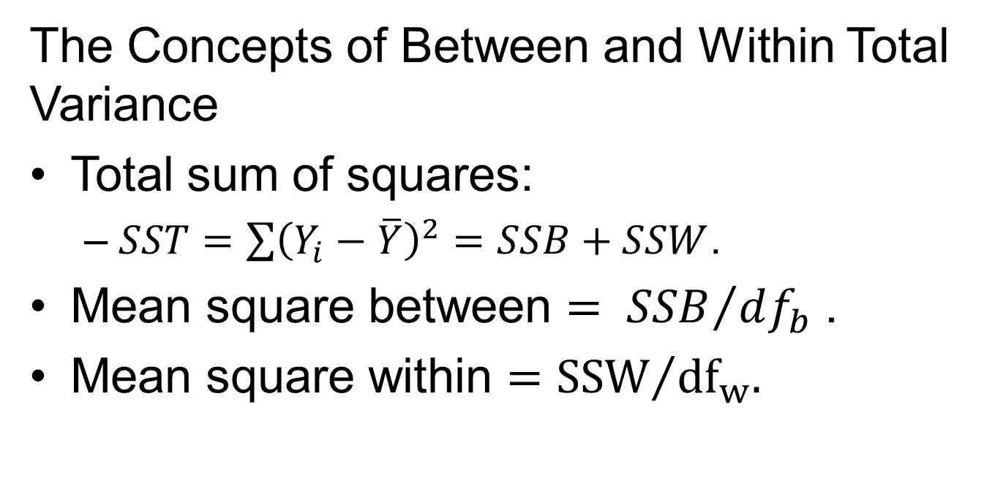
The Structure of Hypothesis Testing with ANOVA (4 of 6)
The Concepts of between and within Total Variance
Total sum of squares:
  $SST=\sum{{\left(Y_{i}−\overline{Y}\right)}^{2}=SSB+SSW}$.
Mean square between $= {SSB}/{df_{b}}$.
Mean square within $={SSW}/{df_{w}}$.
Notes:
Satisfies Learning Objective 11.2: Define the concepts of between and within total variance.
Total sum of squares: The total sum of squares (the total variation in scores, calculated by adding SSB and SSW) or SST can be represented by
$SST=\sum{{\left(Y_{i}−\overline{Y}\right)}^{2}=SSB+SSW}$
where $Y_{i}$ is each individual score, and $\overline{Y}$is the overall mean.
The second part of estimating the between-group and within-group variances is calculating the degrees of freedom. For SSB, the degrees of freedom are determined by
$df_{b}=k−1$
where k is the number of samples.
For SSW, the degrees of freedom are determined by
$df_{w}=N−k$
where N is the total number of cases and k is the number of samples.
Mean square between: Estimating the between-group variance by calculating mean square between, which is the sum of squares between divided by its corresponding degrees of freedom. Simply stated, mean squares are averages computed by dividing each sum of squares by its corresponding degrees of freedom. Mean square between can be represented by $Mean square between= {SSB}/{df_{b}}$.
Mean square within: Estimating the within-group variance by calculating mean square within, which is the sum of squares within divided by its corresponding degrees of freedom, can be represented by $Mean square within={SSW}/{df_{w}}$.

Slide 7

The Structure of Hypothesis Testing with ANOVA (5 of 6)
The F Statistic
F ratio obtained (F statistic): Ratio of ${SSB}/{df_{b}}$ and ${SSB}/{df_{w}}$.
Notes:
Satisfies Learning Objective 11.2: Define the concepts of between and within total variance.
F ratio obtained or F statistic: Together the mean square between and mean square within compose the F ratio obtained or F statistic, which is the test statistic for ANOVA, calculated by the ratio of mean square between to mean square within. The F statistic is the ratio of between-group variance to within-group variance and is determined by
$F=\frac{Mean square between}{Mean square within}=\frac{{SSB}/{df_{b}}}{{SSW}/{df_{w}}}$.
A larger F-obtained statistic means that there is more between-group variance than within-group variance, increasing the chances of rejecting our null hypothesis.
F-critical: The F-test statistic that corresponds to the alpha level, ${df}_{w}$, and ${df}_{b}$.

Slide 8
The Structure of Hypothesis Testing with ANOVA (6 of 6)
Making a Decision
Calculating F statistic and its distribution.
Degrees of freedom.
F-critical and F-obtained.
Notes:
Satisfies Learning Objective 11.2: Define the concepts of between and within total variance.
Calculating F statistic and its distribution: To determine the probability of calculating an F statistic, we rely on the distribution of the F statistic.
Degrees of freedom: There are two degrees of freedom, $df_{1}=df_{b}$ and $df_{2}=df_{w}$. Because of the two degrees of freedom, we’ll have to determine the probability of our F-obtained differently than we did with t test or chi-square.
F-critical and F-obtained:
F-critical: The F-test statistic that corresponds to the alpha level, ${df}_{w}$, and ${df}_{b}$.
F-obtained: The F-test statistic that is calculated.
If the F-obtained is greater than the F-critical, we know that its probability is <0.05, extending into the shaded area.
If the F-obtained was lesser than the F-critical, we could determine that its probability was greater than our alpha of 0.05, in the unshaded area of the F-distribution curve.

Slide 9
Statistics in Practice: The Ethical Consumer
Ethical consumerism.
Questions on consumer purchases.
The ANOVA output.
Notes:
Satisfies Learning Objective 11.4: Determine the significance of an F-ratio test statistic.
Ethical consumerism: Consumers increasingly avoid products that are perceived as having a negative social or environmental impact. By purchasing fair labor, organic or environmentally safe products, consumers express their politics through their purchases, a practice that has been referred to as ethical consumerism.
Questions on consumer purchases: The GSS2014 included a series of questions on what it takes to be a good citizen. Respondents were asked how important it was to “choose products for political, ethical or environmental reasons, even if they cost a bit more.” Answers were ranked on a 7-point scale: 1 = not at all important to 7 = very important. We use SPSS and the GSS2014 data to examine the relationship between responses to this question and political party identification (Democrat, Independent, or Republican).
The ANOVA output:
The ANOVA output includes two tables: (1) descriptives and (2) ANOVA.
In the descriptives table, the N, mean, and standard deviation are reported for each group and the entire sample, along with the 95% confidence interval for each mean.
The F-obtained is reported in the ANOVA table, along with its level of significance (or probability).
Since the level of significance is greater than our alpha, we fail to reject the null hypothesis.
Though the means are different, the differences are not significant.

Slide 10
Reading the Research Literature: College Satisfaction among Latino Students
ANOVA can help us understand how social categories shape lives.
Kim, Rennick, and Franco study.
Notes:
Like bivariate, t test, or chi-square analyses, ANOVA can help us understand how the categories of experience, race, age, class, and/or gender shape our social lives. ANOVA allows us to investigate a variety of social categories by comparing the differences between them.
Research: How ANOVA is interpreted in the social science literature:
Young Kim, Liz Rennick, and Marla Franco investigated the levels of college engagement and satisfaction among Latino undergraduate students attending highly selective colleges and universities in comparison with other racial/ethnic groups.
Kim and their colleagues limited their analyses to the outcomes of 33,415 junior and senior students.
All factors were measured on a 6-point Likert-type scale: 1 =very poor to 6 = excellent.
The findings:
In terms of satisfaction with the educational experience, quality of instruction and courses in the major, advising and out-of-class contact, and library support: Latino students and all other racial/ethnic groups rated equally.
Sense of belonging and overall college satisfaction: White students reported higher levels of satisfaction.
Conclusion: The researchers may argue that the college experiences of Latino students at highly selective research institutions are favorable and meaningful, which may contribute to development in desired educational outcomes at these types of institutions.

